Slide 1
Emergency Response System
Nataraj Mocherla & Sandeep Manchem
CS 6235 Project Presentation

Slide 2
Emergency Response System - Motivation
Create a fast and efficient Emergency Response System which is
Easy to use
On the body of the user
Does not require installation of devices
Inexpensive

Slide 3
Emergency Response System - Demo
The demo system consists of four components
Arduino based emergency button
Mobile Service paired with button
SMS processing emergency response engine
Web interface to track the person in emergency.

Slide 4
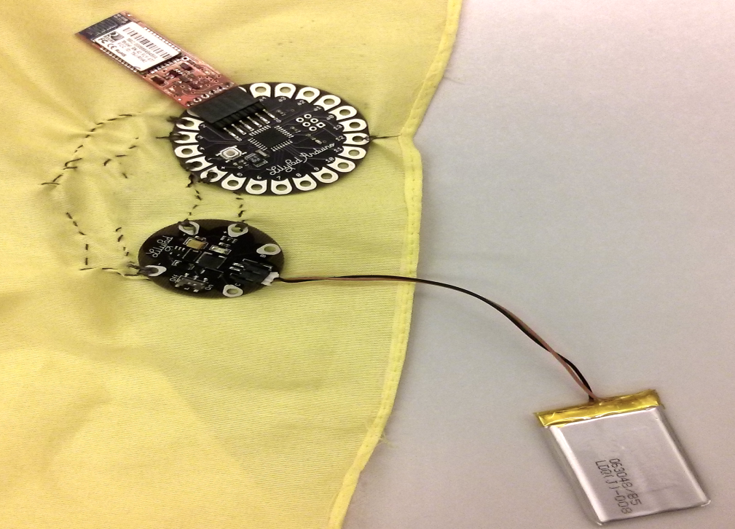
Emergency Response System - Demo
Emergency Button

Slide 5

Emergency Response System - Demo
Mobile Service

Slide 6
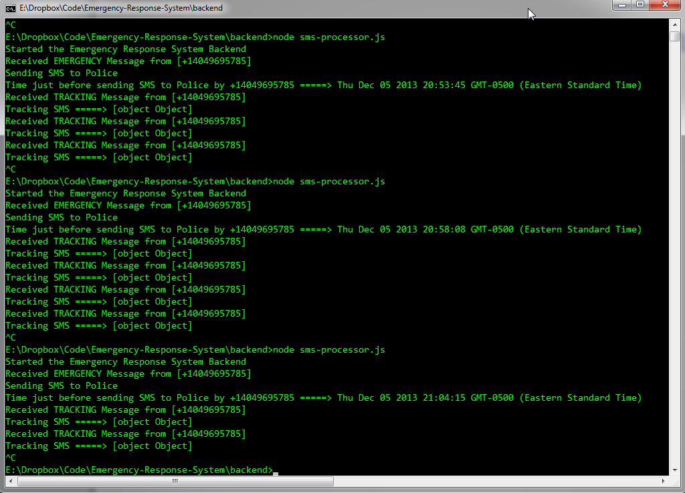
Emergency Response System - Demo
SMS Processing Engine

Slide 7
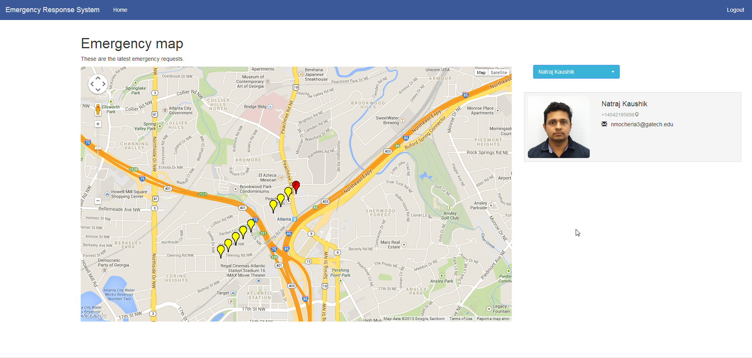
Emergency Response System - Demo
User Interface

Slide 8
Emergency Response System - Usage
Double Click => EMERGENCY
LED glows after sending emergency.

Slide 9
Emergency Response System - Usage
Single Click => CANCEL
If a CANCEL signal is not sent within 30 seconds, an emergency message with the exact location of the user is sent to authorities.
Tracking SMS are sent after sending an Emergency Signal.

Slide 10
Emergency Response System - Usage

Slide 11
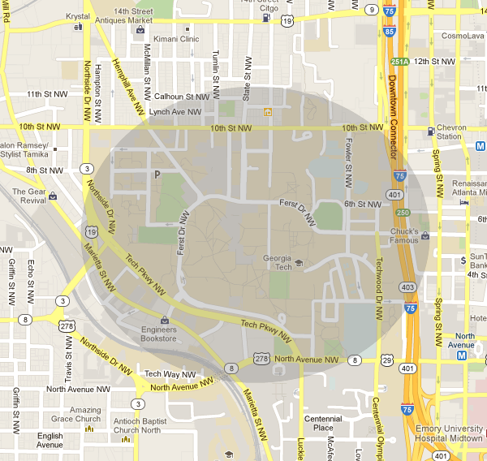
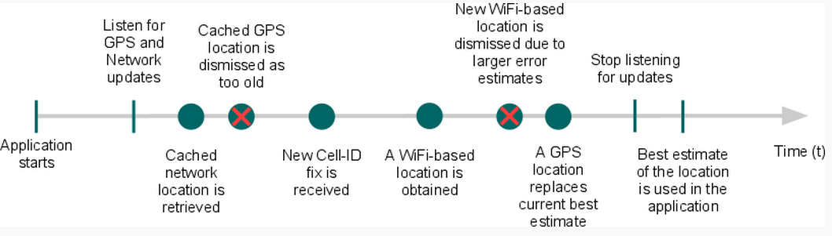
Emergency Response System – Location Detection

Slide 12
Emergency Response System
System cost was around 60$
Everyone uses mobile phones these days. No extra hardware required.
The SMS processing backend is lightweight and extremely scalable.
Emergency messages reaches authorities within 40 seconds of pushing button.

Slide 13
Emergency Response System
System cost was around 60$
Everyone uses mobile phones these days. No extra hardware required.
The SMS processing backend is lightweight and extremely scalable.
Emergency messages reaches authorities within 40 seconds of pushing button.

Slide 14





Emergency Response System

